Slide 1
Diabetes Prediction using Machine Learning (15,000 records)
Kunal (CSC-21F-057)
Subject: Machine Learning

Slide 2
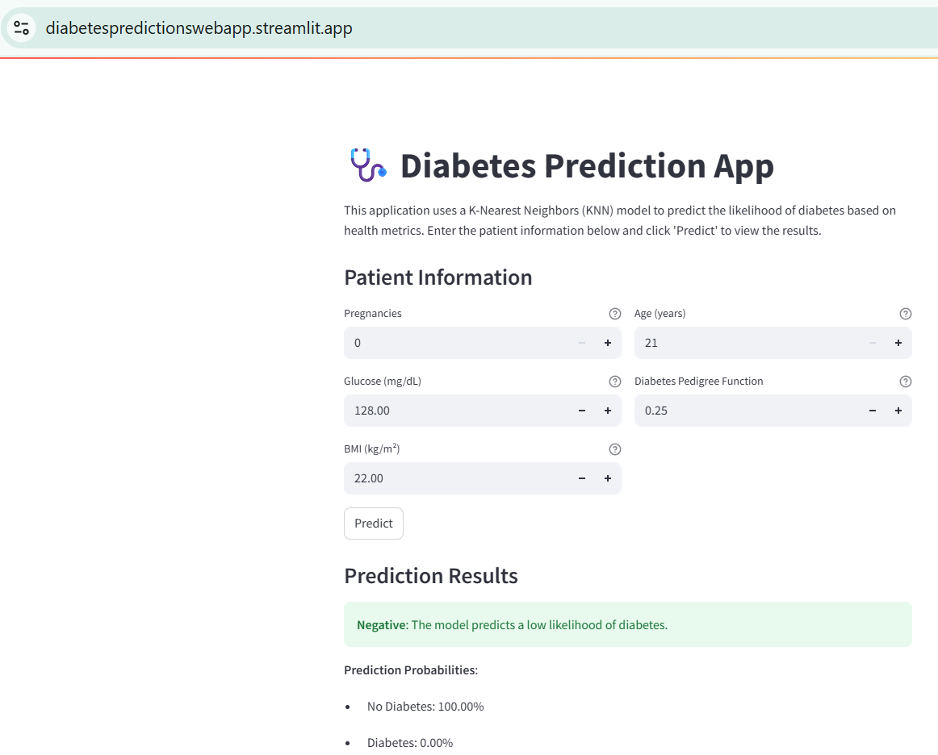
Overview
Please Visit: https://diabetespredictionswebapp.streamlit.app/

Slide 3
Introduction
Diabetes is a chronic condition affecting over 537 million people globally, with early detection being crucial for effective management.
We developed a diabetes prediction system using a K-Nearest Neighbors model trained on a dataset of 15,000 patient records, achieving 98.6% test accuracy. We used the Diabetes Dataset for analysis.
The Streamlit application enables real-time predictions based on user inputs for Pregnancies, Glucose, BMI, Age, and Diabetes Pedigree Function.

Slide 4
Problem Statement
Problem: Can we accurately predict diabetes using patient health data?
Target Variable: Outcome (1 = Diabetes, 0 = No Diabetes)
Features: Glucose, BMI, Insulin, Age, etc.
Aim: Help in early diagnosis using predictive analytics.

Slide 5
Methodology
Steps Followed:
Data Loading & Understanding
Data Exploration
Data Cleaning (Missing values, Outliers)
Data Preparation (Train-test split, Scaling)
Model Training (5 ML Algorithms)
Evaluation using metrics
Model Optimization

Slide 6
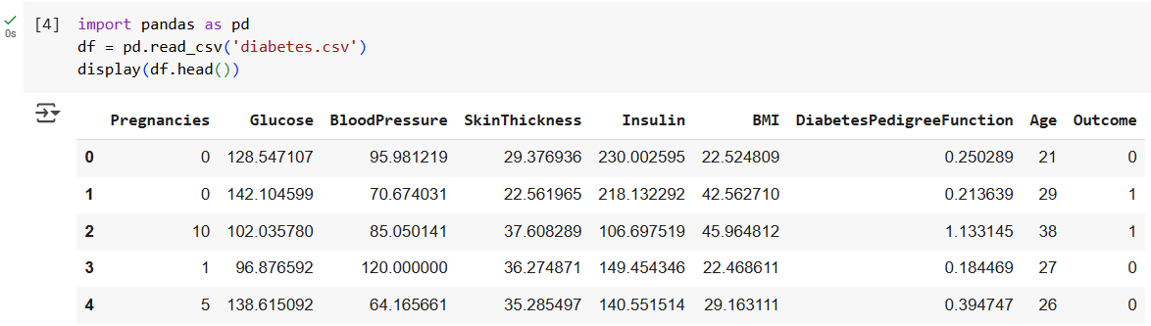
Data Loading
Loaded diabetes dataset using pandas.
Shows first five rows of data.
Kunal (CSC-21F-057)
subject: Machine Learning

Slide 7
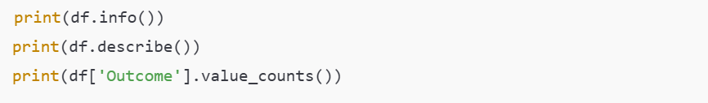
Data Exploration
Identified 0s in columns like Insulin and BMI as missing values.
Class distribution is imbalanced: More 0s (non-diabetic) than 1s.
Statistical overview helped in planning cleaning.

Slide 8
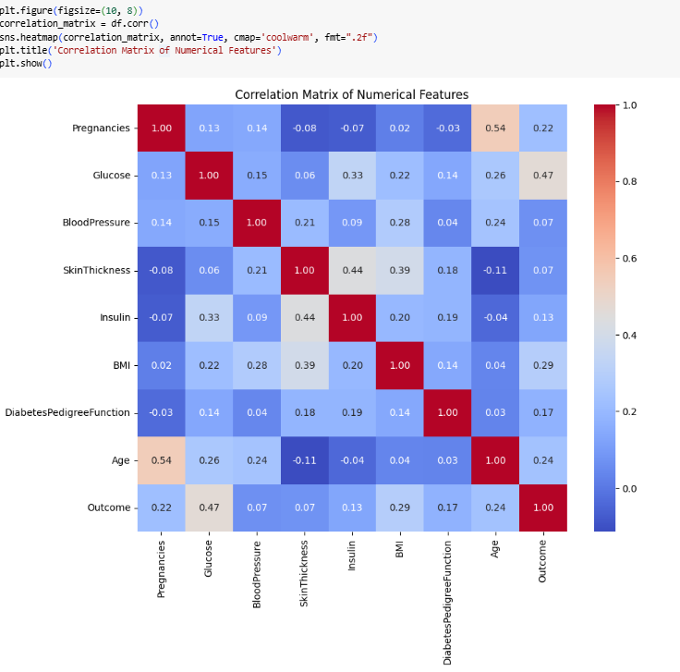
Correlation Matrix
Heatmap showed strong correlation of Glucose and BMI with Outcome.

Slide 9
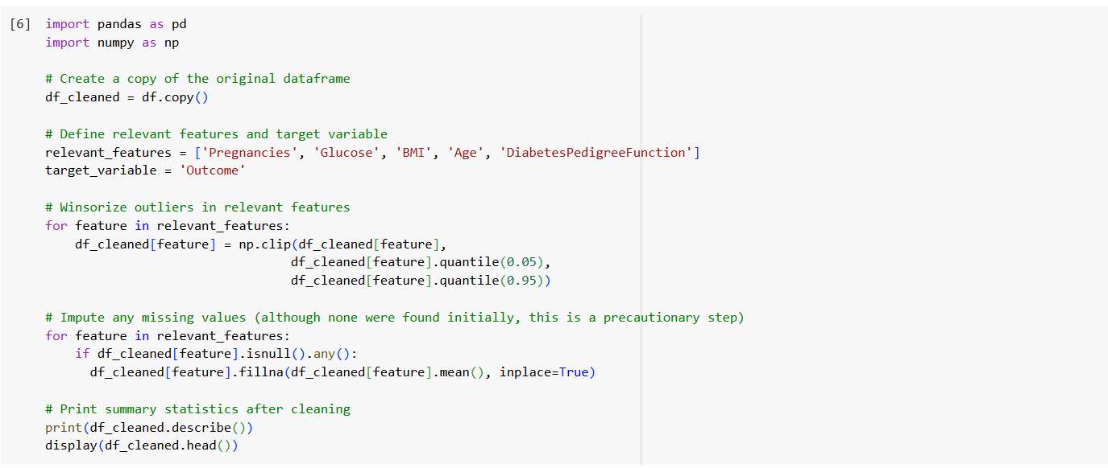
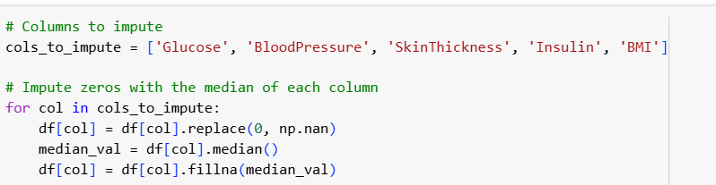
Data Cleaning
Replaced 0s with median values.
Median is robust to outliers.

Slide 10
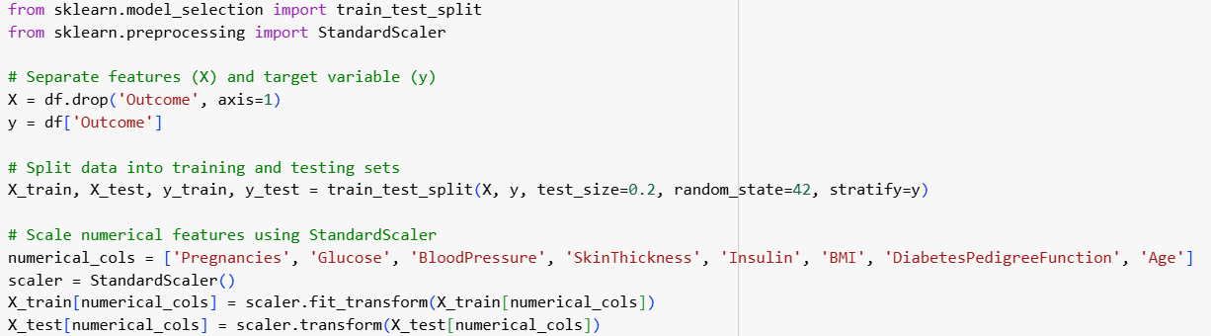
Data Splitting & Scaling
Stratified split for balanced target distribution.
StandardScaler improves model convergence.

Slide 11
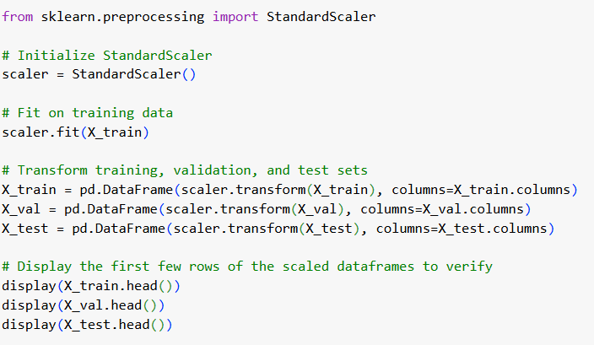
Feature Engineering

Slide 12
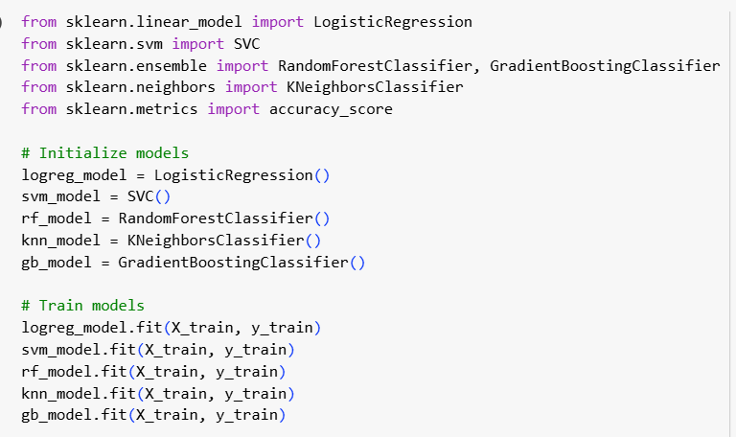
Model Training
Trained 5 ML models for comparison.

Slide 13
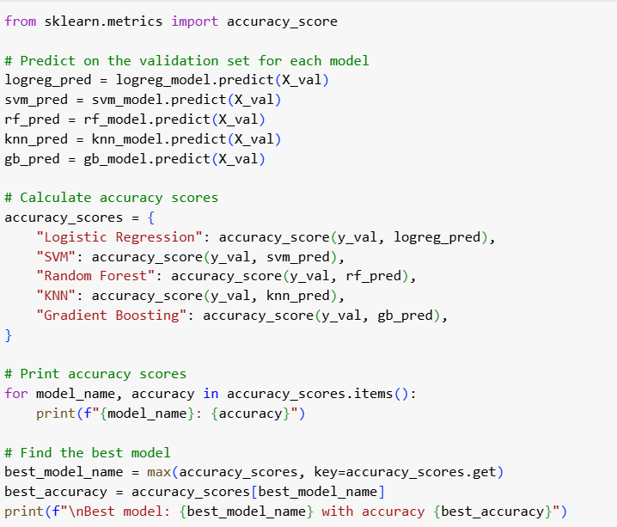
Model Evaluation
Evaluate the performance of each trained model on the validation set and identify the best-performing one based on accuracy.

Slide 14
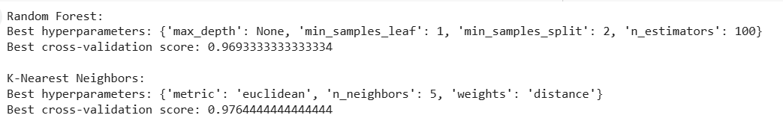
Model Optimization
Optimize the hyperparameters of the RandomForestClassifier and KNeighborsClassifier models.

Slide 15
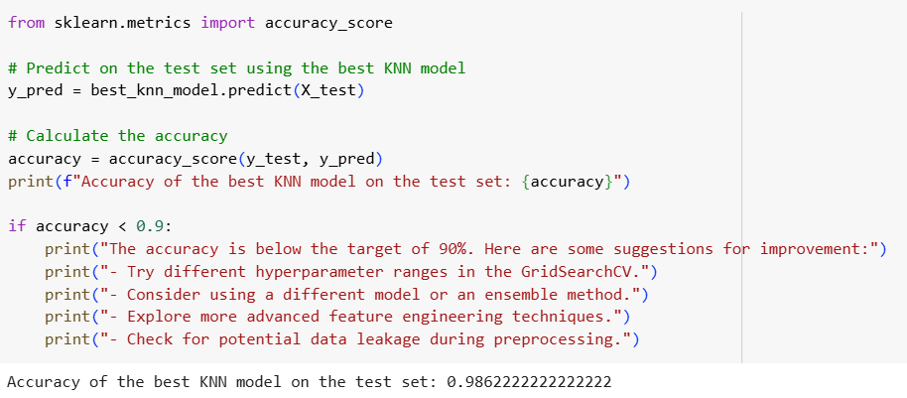
Model Evaluation
Evaluate the best performing model (KNN) on the test set.

